Slide 1
PDFBox
Charlie Boggus, Sean Walston, Carson Susich, Kyle Kempf, Kyrne Beauford

Slide 2
Purpose
PDF conversion is an everyday occurence in business. However safe conversion is not.
Our product aims to bridge the gap between the two by providing safe and reliable PDF conversion
Our patent pending conversion ensures quick and easy conversion of Microsoft Word, Powerpoint and Excel documents.
We aim to become the one stop shop for safe, easy, and reliable PDF conversion eliminating the need to purchase expensive software or place important business documentation in the hands of an unsafe site.
With PDFBox we aim to give power back to the users, eliminating a roadblock in the users quest to success

Slide 3
The Users
The site is designed with users in mind
Its a quick conversion
Site is easy to use
The site is designed with 3 clicks mentality, meaning a user can find what they are looking for within 3 clicks
Most importantly the site is SECURE
The site uses high level encryption to protect user information as well as preserve the safety of their documents
The Site is also designed with minimally invasive ads that will not hinder the user experience. No pop ups will ever be found on the site because the user comes first

Slide 4
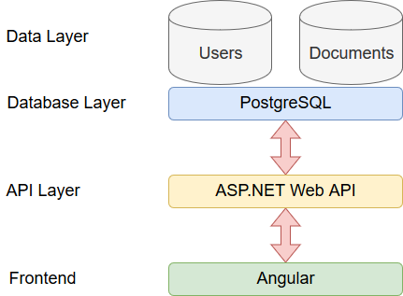
Architecture: Overview

Slide 5
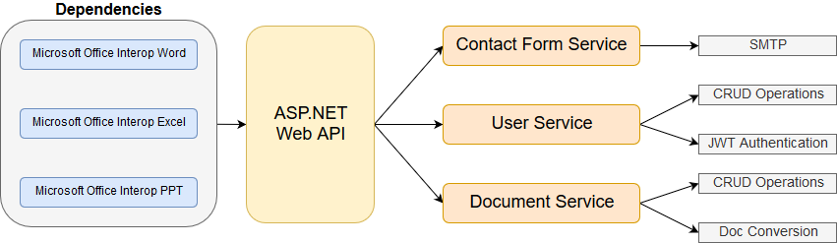
Architecture: API Overview

Slide 6
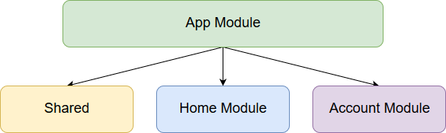
Architecture: Frontend Overview

Slide 7
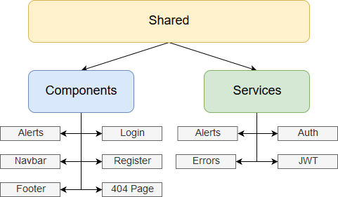
Architecture: Frontend Overview

Slide 8
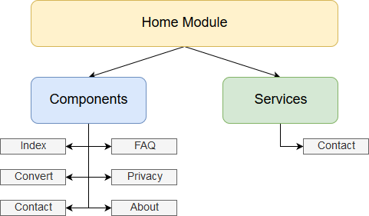
Architecture: Frontend Overview

Slide 9
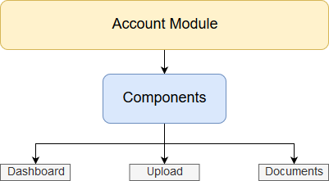
Architecture: Frontend Overview

Slide 10
Architecture: Design Decisions
Microsoft Office Interop Libraries:
Free libraries to interface with the Microsoft Office suite from a C# application
Unfortunately, these libraries do not work in a server environment due to them requiring and executing a local installation of office every time they are used
Since we’re poor college students, though, this was our only option for the purposes of this project
In a professional setting (with actual money to spend on proprietary libraries) we’d use the Aspose libraries which cost $2000+ for a license

Slide 11
Architecture: Requirements
Availability:
The system should have standard availability that most users expect from a website (24/7)
Performance:
The system should perform reasonably fast
Users do not want to wait 30 minutes for a document to be uploaded/converted
Reliability:
The system should reliably convert the supported documents to PDF. Basically, when a user uploads and converts a .docx, they should expect to get a valid .pdf file in return
The system should reliably store user data and documents. Loss of data on this platform would be unacceptable as it is essentially a cloud-storage platform.

Slide 12
Architecture: Requirements (cont.)
Scalability:
Due to the simplistic design of the application it is easily scalable to different types of demand
No limits on the amount of users or documents that can be stored in DB
No slowdowns from large amounts of traffic (web traffic or api request/operation traffic)
Security:
PDFBox stores sensitive user data (such as usernames, emails, and passwords)
Password information is encrypted using HMAC SHA512 encryption
Usability:

Slide 13
Outcomes
Measures of success:
Monthly users and growth rate per month
Site traffic, traffic sources, bounce rate
Ad real estate availability and clicks per ad
Pivot time:
Unable to maintain growth strategy for 6 months
Fold if 1 year goes by
Not profitable for 1 year, pivot
Fold after a year and a half

